Slide 1
UNIT I – BASICS OF SDN
UNIT I – SESSION 1
SESSION 5
1.Control and data planes
2.The Control Plane
3.Data Plane
4.Moving Information Between Planes
5.Separation Importance
Reference: Ref. 2, Ch.2 (Page. 11 to Page 28)

Slide 2
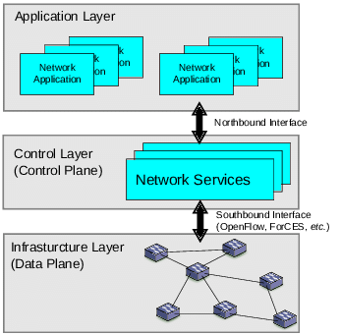
Control and data planes
SDN is the potential advantage in the separation of a network device’s control and data planes.
This separation affords a network operator certain advantages in terms of centralized or semi-centralized programmatic control.
It also has a potential economic advantage based on the ability to consolidate in one or a few places what is often a considerably complex piece of software to configure and control onto less expensive, so-called commodity hardware
https://www.youtube.com/watch?v=P9ZMugAf9lU&t=44s
https://www.youtube.com/watch?v=7wnztxyv74g

Slide 3
1.Control plane and its functionality
The control plane is the part of a network that controls how data packets are forwarded — meaning how data is sent from one place to another.
The process of creating a routing table, for example, is considered part of the control plane.
Routers use various protocols to identify network paths, and they store these paths in routing tables.
The protocols, logic, and algorithms that are used to program the forwarding plane reside in the control plane. Many of these protocols and algorithms require global knowledge of the network.
The control plane determines how the forwarding tables and logic in the data plane should be programmed or configured.
.
https://www.youtube.com/watch?v=FVKUip3cE08&t=201s

Slide 4
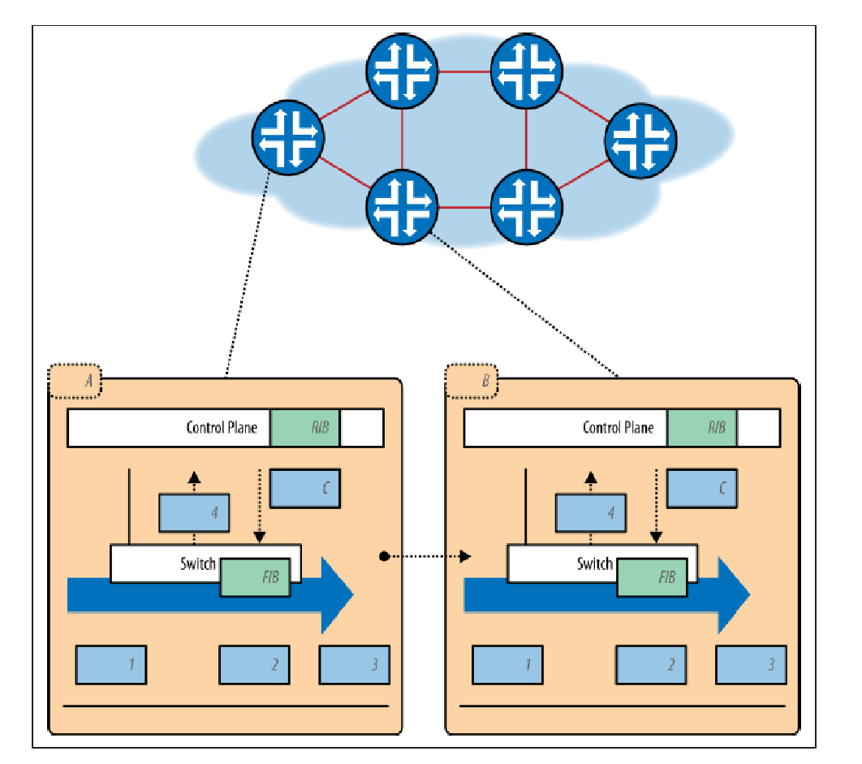
At a very high level, the control plane establishes the local data set used to create the forwarding table entries, which are in turn used by the data plane.
The data set used to store the network topology is called the routing information base (RIB). The RIB is often kept consistent (i.e., loop-free) through the exchange of information between other instances of control planes within the network.
Forwarding table entries are commonly called the forwarding information base (FIB) and are often mirrored between the control and data planes of a typical device. The FIB is programmed once the RIB is deemed consistent and stable.

Slide 5
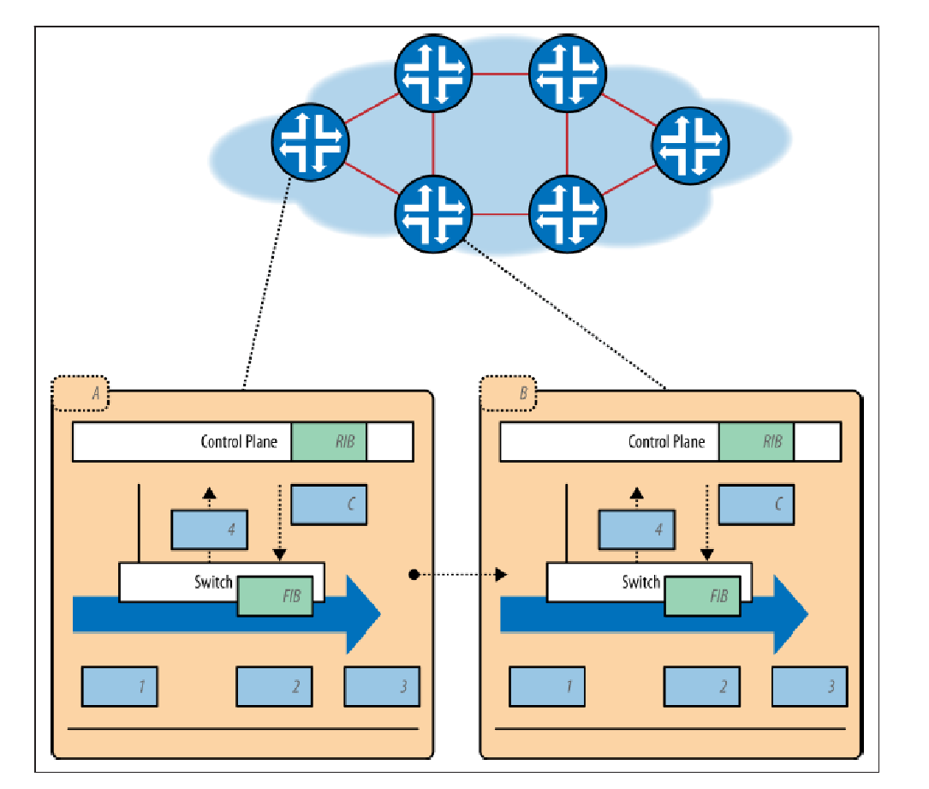
1.1 The mechanics of the control and data planes in switch
At the top of the figure, a network of switches is shown, with an expansion of the details of the control and data planes of two of those switches (noted as A and B).
In the figure, packets are received by switch A on the leftmost control plane and ultimately forwarded to switch B on the righthand side of the figure.
Inside each expansion, note that the control and data planes are separated, with the control plane executing on its own processor/card and the data plane executing on a separate one. Both are contained within a single chassis
In the figure, packets are received on the input ports of the line card where the data plane resides. If, for example, a packet is received that comes from an unknown MAC address, it is punted or redirected (4) to the control plane of the device, where it is learned, processed, and later forwarded onward.
This same treatment is given to control traffic such as routing protocol messages (e.g., OSPF link-state advertisements). Once a packet has been delivered to the control plane, the information contained therein is processed and possibly results in an alteration of the RIB as well as the transmission of additional messages to its peers, alerting them of this update (i.e., a new route is learned). When the RIB becomes stable, the FIB is updated in both the control plane and the data plane. Subsequently, forwarding will be updated and reflect these changes.

Slide 6
However, in this case, because the packet received was one of an unlearned MAC address, the control plane returns the packet (C) to the data plane (2), which forwards the packet accordingly (3).
If additional FIB programming is needed, this also takes place in the (C) step, which would be the case for now the MAC addresses source has been learned.
The same algorithm for packet processing happens in the next switch to the right

Slide 7
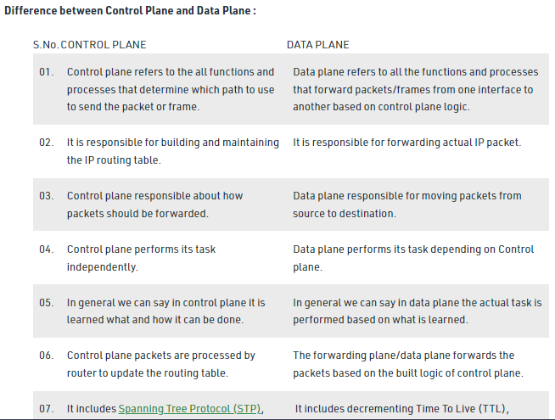

Slide 8
2.Control plane for the Internet
The control plane for the Internet is some combination of layer 2 or layer 3 control planes
A layer 2 control plane focuses on hardware or physical layer addresses such as IEEE MAC addresses. A layer 3 control plane is built to facilitate network layer addresses such as those of the IP protocol.
In a layer 2 network, the behaviors around learning MAC addresses, the mechanisms used to guarantee an acyclic graph (familiar to most readers through the Spanning Tree Protocol), and flooding of BUM (broadcast, unicast unknown, and multicast) traffic create their own scalability challenges and also reveal their scalability limitations.
In a layer 2 network, forwarding focuses on the reachability of MAC addresses. Thus, layer 2 networks primarily deal with the storage of MAC addresses for forwarding purposes.
In a layer 3 network, forwarding focuses on the reachability of network addresses. Layer 3 network reachability information primarily concerns itself with the reachability of a destination IP prefix. This includes network prefixes across a number of address families for both unicast and multicast. In all modern cases, layer 3 networking is used to segment or stitch together layer 2 domains in order to overcome layer 2 scale problems

Slide 9
Layer 3 routers are connected together to form larger networks—or really different subnetwork address ranges. Larger networks connect to other networks via gateway routers that often specialize in simply interconnecting large networks.
The router routes traffic between networks at layer 3 and will only forward packets at layer 2 when it knows the packet has arrived at the final destination layer 3 network that must then be delivered to a specific host.
Some notable blurring of these lines occurs with the Multiprotocol Label Switching (MPLS) protocol, the Ethernet Virtual Private Network (EVPN) protocol, and the Locator/ ID Separation Protocol (LISP).
The MPLS protocol—really a suite of protocols— was formed on the basis of combining the best parts of layer 2 forwarding (or switching) with the best parts of layer 3 IP routing to form a technology that shares the extremely fast-packet forwarding that ATM invented with the very flexible and complex path signaling techniques adopted from the IP world.
The EVPN protocol is an attempt to solve the layer 2 networking scale problems by effectively tunneling distant layer 2 bridges together over an MPLS (or GRE) infrastructure—only layer 2 addressing and reachability information exchanged over these tunnels and thus does not contaminate (or affect) the scale of the underlying layer 3 networks
LISP attempts to solve some of the shortcomings of the general distributed control plane model as applied to multihoming, adding new addressing domains and separating the site address from the provider in a new map and encapsulation control and forwarding protocol.

Slide 10
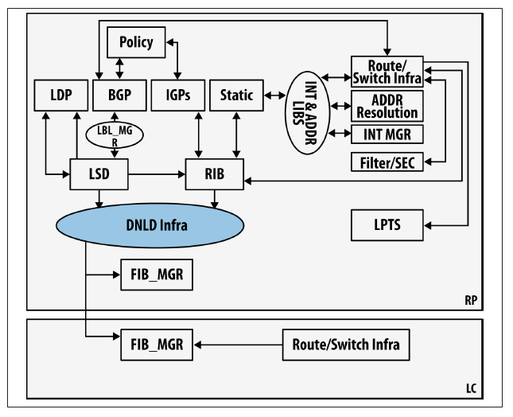
Control and data planes of a typical network device
Because some services have very tight performance loops (for short event detection times they are almost invariably local to the data plane—regardless of the strategy chosen for the control plane.
This is depicted in Figure by showing the various routing protocols as well as RIB-to-FIB control that comprises the heart of the control plane. Note that we do not stipulate where the control and data planes reside, only that the data plane resides on the line card (shown in Figure the LC box),and the control plane is situated on the route processor (denoted by the RP box).

Slide 11
3.Data Plane
In contrast to the control plane, which determines how packets should be forwarded, the data plane actually forwards the packets. The data plane is also called the forwarding plane.
Routing table, forwarding table and the routing logic constitute the data plane function
The data plane handles incoming datagrams (on the wire, fiber, or in wireless media) through a series of link-level operations that collect the datagram and perform basic sanity checks.
A well-formed (i.e., correct) datagram is processed in the data plane by performing lookups in the FIB table (or tables, in some implementations) that are programmed earlier by the control plane. This is sometimes referred to as the fast path for packet processing because it needs no further interrogation other than identifying the packet’s destination using the preprogrammed FIB.
The one exception to this processing is when packets cannot be matched to those rules, such as when an unknown destination is detected, and these packets are sent to the route processor where the control plane can further process them using the RIB.
It is important to understand that FIB tables could reside in a number of forwarding targets—software, hardware-accelerated software (GPU/CPU, as exemplified by Intel or ARM), commodity silicon (NPU, as exemplified by Broadcom, Intel, or Marvell, in the Ethernet switch market), FPGA and specialized silicon (ASICs like the Juniper Trio), or any combination4—depending on the network element design.
https://www.youtube.com/watch?v=FVKUip3cE08&t=201s

Slide 12
Data plane functionality
Forwarding functionality, including the logic and tables for choosing how to deal with incoming packets based on characteristics such as MAC address, IP address, and VLAN ID, resides in the forwarding plane.
The fundamental actions performed by the forwarding plane can be described by the way it dispenses with arriving packets. It may forward, drop, consume, or replicate an incoming packet. For basic forwarding, the device determines the correct output port by performing a lookup in the address table in the hardware ASIC.
A packet may be dropped due to buffer overflow conditions or due to specific filtering resulting from a QoS rate-limiting function, for example. Special-case packets that require processing by the control or management planes are consumed and passed to the appropriate plane.
Finally, a special case of forwarding pertains to multicast, where the incoming packet must be replicated before forwarding the various copies out different output ports.

Slide 13
3.1.Software and hardware forwarding
The software path - exemplified by CPU-driven forwarding of the modern dedicated network element (e.g., router or switch), which trades off a processor intensive lookup for the seemingly limitless table storage of processor memory.
lookups in hardware tables have proven to result in much higher packet forwarding performance and therefore have dominated network element designs, particularly for higher bandwidth network elements.
However, recent advances in the I/O processing of generic processors, spurred on by the growth and innovation in cloud computing, are giving purpose-built designs, particularly in the mid-to-low performance ranges, quite a run for the money.
The differences in hardware forwarding designs are spread across a variety of factors, including (board and rack) space, budget, power utilization, and throughput target requirements.
These can lead to differences in the type (speed, width, size, and location) of memory as well as a budget of operation (number, sequence, or type of operations performed on the packet) to maintain forwarding at line rate (i.e., close to the maximum signaled or theoretical throughput for an interface) for a specific target packet size (or blend).
Ultimately, this leads to differences in forwarding feature support and forwarding scale (e.g., number of forwarding entries, number of tables) among the designs

Slide 14
The typical actions resulting from the data plane forwarding lookup are forward (and in special cases such as multicast, replicate), drop, re-mark, count, and queue. Some of these actions may be combined or chained together.
In some cases, the forward decision returns a local port, indicating the traffic is destined for a locally running process such
as OSPF or BGP. These datagrams take what is referred to as the punt path whereby they leave the hardware-forwarding path and are forwarded to the route processor using an internal communications channel. This path is generally a relatively low-throughput path, as it is not designed for high-throughput packet forwarding of normal traffic.

Slide 15
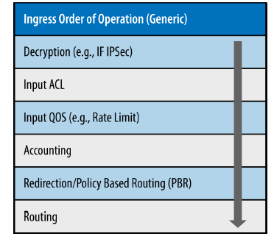
3.2.Generic example of ingress feature application on a traditional router/switch
In addition to the forwarding decision, the data plane may implement some small services/ features commonly referred to as forwarding features (exemplified by Access Control Lists and QoS/Policy). In some systems, these features use their own discrete tables, while others perform as extensions to the forwarding tables (increasing entry width).
Additionally, different designs can implement different features and forwarding operation order (Figure ). Some ordering may make some feature operations exclusive of others.
With these features, you can locally alter or preempt the outcome of the forwarding lookup. For example:
• An access control list entry may specify a drop action for a specific matching flow
(note that in the ACL, a wider set of parameters may be involved in the forwarding
decision). In its absence, there may have been a legitimate forwarding entry and
thus the packet would NOT be dropped.
• A QOS policy can ultimately map a flow to a queue on egress or remark its type of service (TOS)/class of service(COS) to normalize service with policies across the network. And, like the ACL,it may mark the packet to be dropped (shaped) regardless of the existing forwarding entry for the destination/flow.

Slide 16
4.Moving Information Between Planes
The internal function of larger, multislot/multicard (chassis-based) distributed forwarding systems of today mimic some of the behaviors of the logically centralized but physically distributed control mechanisms of SDN. Particularly those aspects of the distribution of tables and their instantiation in hardware .
Why communication and information movement?
An examination of the inner workings of a typical distributed switch reveals a number of functions and behaviors that mimic those of an externalized control plane. For example, in systems where the control plane resides on an independent processor/line card and data planes exist on other, independent line cards, certain behaviors around the communication between these elements must exist for the system to be resilient and fault tolerant.
It is worth investigating whether or not all of these are needed if the control plane is removed from the chassis and relocated further away (i.e., logically or strictly centralized).

Slide 17
Information exchanges between planes
basic packet forwarding: When the data plane is instructed by the control plane to forward packets, does the data plane listen? And does it listen for each and every packet it receives?
mechanisms for detecting forwarding table distribution errors can be embedded in the data (e.g., table versioning) or in the transfer mechanism (e.g., signing the table with some form of hash or cookie generated from its contents). Such mechanisms ensure that the distributed software versions of the table are synchronized and correct once programmed.
verification routines between the software version of the table and the hardware version are implemented in the memory driver software (specific to the forwarding hardware).
Some vendors have implemented routines to verify hardware entries post facto—after the control plane programs the data plane—checking for soft errors in the forwarding chip and ancillary memories. In these cases, there are associated routines to mark bad blocks, move entries, and references.
In general, these hardware verification routines are expensive, so they are often implemented as a background (a.k.a. scavenger) processes.
The transfer and memory write routines are optimized to reduce transaction overhead, commonly by batching and bulking techniques .
Some multislot/multicard systems do two-stage lookups wherein the first stage at entrance simply identifies the outgoing slot/card on which a secondary lookup is performed.
Depending on how it’s implemented, two-stage lookups can enable an optimization that allows a phenomenon called localization to reduce the egress FIB size. In these cases, scenarios around two-stage asynchronous loss may occur that require some attention and are in fact difficult to detect until they fail.

Slide 18
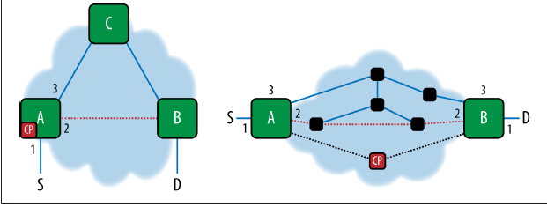
4.1.Two-stage lookup- Two-stage asynchronous loss
The left side of Figure shows a multislot router/switch that does a two-stage lookup.
When link A-B comes up, the resulting FIB ingress lookup on card 1 changes from card 3 to card 2. If the update to card 2 happens after 1 and 3, then the secondary lookup (on egress) will fail.
Similarly, in an SDN environment (shown in the cloud on the right side), if the tunnel connecting A and B changes from interface 3 (respectively) to interface 2 on these systems (due to an administrative or network event)—then the mapping of flows from 1–3 to 1–2 on these elements has to be synchronized by the application on the SDN controller (CP).

Slide 19
5.Why Can Separation Be Important?
https://www.youtube.com/watch?v=7wnztxyv74g
https://www.youtube.com/watch?v=2TeWpWVHVCE
Separation of the control and data planes
Usually, the control plane is separated from the data plane, allowing it to become more efficient and scalable. Furthermore, there are distributed and centralized control planes. Those centralized planes are managed by a central controller responsible for making decisions and managing the behavior of network devices.
. For example, any multislot router/switch built in the last 10 years or so has its control plane (i.e., its brain) executing on a dedicated processor/card (often two for redundancy) and the switching functions of the data plane executing independently on one or more line cards, each of which has a dedicated processor and/or packet processor.
Figure illustrates this by showing the route processor engine (denoted as the route processor box).
In Figure , the data plane is implemented in the lower box, which would be a separate line card with dedicated port processing ASICs connected to the ingress and egress ports on the line card (i.e., Ethernet interfaces).
Under normal operation, the ports have forwarding tables that dictate how they process inbound-to-outbound interface switching. These tables are populated and managed by the route processor’s CPU/control plane program or programs.
When control plane messages or unknown packets are received on these interfaces, they are generally pushed up to the route processor for further processing. Think of the route processor and line cards as being connected over a small but high-speed, internal network because in reality this is in fact how modern switches are built.

Slide 20
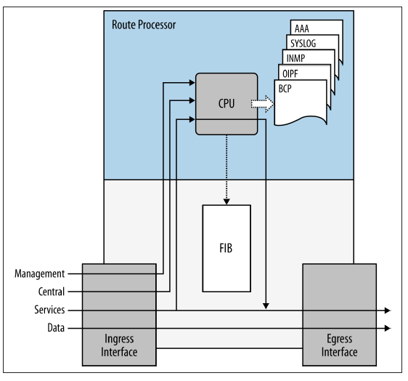
In addition to this, some protocols are actually designed with this architecture in mind to optimize and enhance their behavior. For example, the Multiprotocol Label Switching (MPLS) protocol carries control traffic using the IP protocol suite, which ideally would be implemented on a dedicated route processor engine running a general-purpose CPU, while leveraging a fixed label-based switching paradigm that is best suited to more simplified yet far higher-performance packet processor engine on a different line card.
In addition to those components and a lot of internal infrastructure that was largely hidden from the external observer of those systems, the resulting packaging of these components led to the proliferation of purpose-driven network elements.
These elements were often built on the same hardware family base and varied in throughput efficiency (and complexity) based on the emphasis on balance between service, management, control, and data planes.
The interdependencies created by this very tight coupling of planes create problems (motivation) that revolve around innovation, stability, and scale that ultimately leads to high-performance in all of these areas.
However, these designs suffer from high cost due to their enormous complexity, which is one motivational angle for SDN.
Control and data plane example implementation

Slide 21
5.1.Scale Matters
The scalability of a routing and switching system can take place in myriad ways, coupled with issues that might range from raw packet forwarding performance to power consumption, just to name a few. Ultimately, these scaling issues revolve around a number of trade-offs that tug between cost and performance:
• The service cards are limited to a certain amount of subscriber/flow/service state that they can support for a particular generation of the card. Further, because service cards (particularly those that use special embedded CPUs) have to use a vendor specific system interconnection and switching fabric, there is a significant lag between the availability of a new family of processors (or new processors within the family currently employed on the card) and a new service card that takes advantage of that innovation.
The bottom line here is that it takes considerable time to do additional custom design. This unfortunately leads to added system cost.
• Forwarding cards could support a certain scale of forwarding entries for a particular generation of forwarding chip design, but some of these cards have separate, local slave or peer processors to the control processor on the control board, and these in turn have local processing limitations of their own—for example, running flow sampling on the forwarding card CPU in some designs could drive the local CPU utilization up and consume the CPU processing budget for the system.
The control card memories can handle a certain route scale or other state and have processing limitations based on the generation of the CPU complex on the card, but this memory is also used to store control protocol state and management such as BFD or SNMP. This memory is most expensive.

Slide 22
5.2.Evolution
The network operator had to follow a hardware upgrade path to solve the scale or processing related problems of the control plane. While doing this, the operator had to keep an eye on the forwarding card scale as well as the price-to-performance numbers to pick just the right time to participate in an upgrade.
One way equipment vendors tried to help this situation was by separating the control and data planes apart so that they could evolve and scale independently—or at least much better than if they were combined.
Further, dissecting the control plane from the management processes further provides some level of scale impact isolation by running those user-level processes on COTS hardware within the router/switch, or even remotely.
Hardware forwarding components will still follow an upgrade cycle of their own to deal with forwarding scale regardless of the control plane (i.e., route processor) configuration.
Upgrades due to bandwidth/throughput demands of a forwarding platform are part of a normal aggregation scheme, where great parts of the lower speed forwarding components are typically repositioned at layers closer to the edges of the network (this is potentially a more likely scenario as their function becomes more generic).

Slide 23
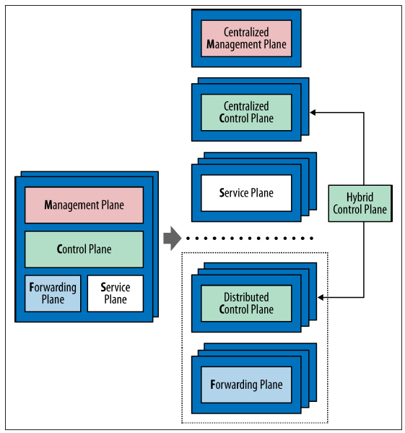
Separating the integrated management, control, service, and forwarding planes so that they can scale independently

Slide 24
5.3.Cost
Cost has capital (CAPEX) and operational (OPEX) components.
Cost is driven by its companions: scale (a CAPEX driver), complexity, and stability (OPEX drivers).
CAPEX—for many customers (particularly service providers or large enterprises with data center operations), the cost of processing power is very cheap on generic compute (COTS) in comparison to the cost of processing and control cards drive some of this cost differential.
This cost differential is also driven by a margin expectation of the vendor for the operating system (those control, management, and service processes), which are not always licensed separately.
It’s a way to recover their investment in their intellectual property and fund ongoing maintenance and development.
While SDN will definitely reduce the hardware integration component of this cost, the component that is the vendor’s intellectual property (control or service) may be repriced to what the vendor perceives as its true value (to be tested by the market). Additionally, an integration cost will remain in the software components.

Slide 25
5.4.Innovation
There are innovation benefits from the separation of the control and data planes (the argument is stronger when considering the separation of the service plane as well).
Separation can benefit the consumer by changing the software release model in a way that enables innovations in either plane to proceed independently from each other (as compared to the current model in which innovations in either plane are gated by the build cycle of the multipurpose integrated monolith).
More relevant to the control/data separation would be the ability to support the introduction of new hardware in the forwarding plane without having to iterate the control plane (for example, the physical handling of the device would be innovation in the data plane component via new drivers).

Slide 26
5.5.Stability
Issues in separation: separation of planes in an SDN , there will probably be some subcomponents of the control plane that cannot be centralized and that there will be a local agent (perhaps more than one) that accepts forwarding modifications and/or aggregates management information back to the central control point.
In spite of these realities, by separating the control and data planes, the forwarding elements may become more stable by virtue of having a smaller and less volatile codebase.
The gradual development of features in areas like Multiprotocol Label Switching (MPLS) followed a meandering path of feature upgrades bloats the code bases of existing implementations. This bloat leads to overly complex and ultimately fragile.
The same functionality using centralized label distribution to emulate the functionality of the distributed LDP or RSVP and a centralized knowledge of network topology could be done with a codebase at least an order of magnitude smaller than currently available commercial codebases.
The natural claim is that in a highly prescriptive and centralized control system, the network behavior can approach that of completely static forwarding, which is arguably stable.

Slide 27
5.6.Complexity and its resulting fragility
The question of how many control planes and where these control planes are located directly impacts the scale, performance, and resiliency—or lack thereof, which we refer to as fragility—of a network.
network operators plan on deploying enough devices within a network to handle some percentage of peak demand. In traditional routing and switching systems, it’s important to understand how much localized forwarding throughput demand can be satisfied without increasing the number of managed devices and their resulting control protocol entities in the network.
for each device deployed, a control plane instance will be brought up to control the data plane within that chassis
how does this additional control plane impact the scale of the overall network control plane for such things as network convergence (i.e., the time it takes for the entirety of running control planes to achieve and agreed upon a loop-freestate of the network)?
it does impact the resiliency and performance of the overall system, and the greater the number of control planes, the potential at least exists for additional fragility in the system.

Slide 28
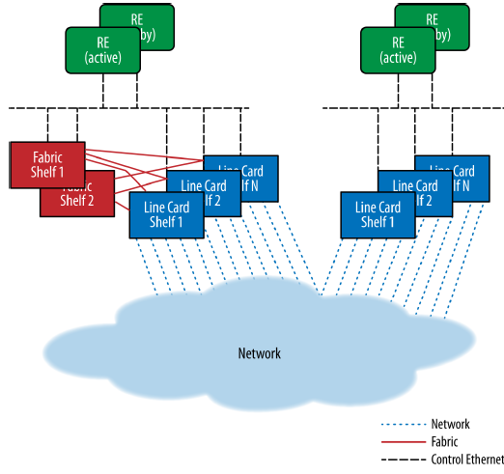
Complexity handling -The cluster and multichassis system designs
Initially, an effort to curtail the growth of control planes was addressed by creating small clusters of systems from stand-alone elements.
Each element of the cluster was bonded by a common inter-chassis data and control fabric that was commonly implemented as a small, dedicated switched Ethernet network.
The multichassis system took this concept a step further by providing an interconnecting fabric between the shelves and thus behaved as a single logical system, controlled by a single control plane.
Connectivity between the shelves was, however, implemented through external (network) ports, and the centralized control plane uses multiple virtual control plane instances—one per shelf.
It was also managed as such it revealed a single IP address to the network operator, giving them one logical entity to manage. Figure demonstrates both approaches.
an external control plane constructed of an interconnecting Control Ethernet network (implemented via redundant Ethernet switches) allows the flow of external control protocol packets forwarding table updates and infrastructure management messaging between processors on the line card (port) shelves and the control processors (e.g., route engine).

Slide 29
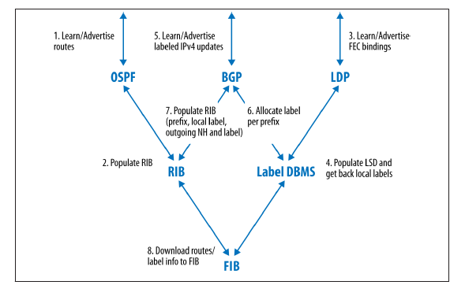
Complexity handling-Process interaction in an IGP/BGP/MPLS network
Two strategies to the control of these systems: 1.distributing processing across the control points in the chassis (process placement) to more fully utilize the processing power (and spread the scale)
2.centralizing the processing on an outboard control system (that is wired into the control fabric of the system)- potentially moves the scale point to one more modular and technologically
There is also the potential to reduce the number and interaction of protocols required to create forwarding state in the elements
Figure shows the process interaction in an IGP/BGP/MPLS network to learn/advertise prefixes and label bindings to populate forwarding in the data plane.
Label Distribution Protocol (LDP) is a protocol in which routers capable of Multiprotocol Label Switching (MPLS) exchange label mapping information.

Slide 30
1. What is a 'plane' in networking?
2. What protocols do routers use to create their routing tables?
3. What is network topology?

